Slide 1
Blackspit Island
Placeholder Town
Cirque du SoLame remnants
Captain Dread
Kiosk
Nihongo Nohondes
The Mariachi Commando
Navigation Room
Port Machete
Pier
Substampede
Frontyard
Artificial Thundercano Hideout
Chimichanga's Monkey Laundry
A Baby's Shack
A Baby
Captain's Room
Dormroom
Bearded Lady
Candy Vault
Entrance
Announcer Booth
Throne of Horrors Room
Maniacal Laughter
Cutter McGreen
Spooch
Hightower
Lord Goat
Evil Deeds College
Kung FOOM!
Bruise Li
Ventriloquist
Diabolical Machines
Mech-alomaniac
Rector's Dorm
Rector's Office
Rector

Slide 2
Substampede Tasks
Repair pedal
Ruppert´s pedal breaks, Nihongo Nohondes walks to the end of the sub to find it and remains there
Find da Vinci's Perpetual Movement Machine blueprint
Only interactive object in the room is a paper on the floor. da Vinci's blueprint for his Perpetual Movement Machine (http://www.rlt.com/14100).
Enter Captain's Room
Find tools: bag of hammers, portrait stand, glue, helm
Only 3 interactive objects in room(complete disorder): required ones to build Perpetual Movement Machine.
Assemble da Vinci's Perpetual Movement Machine
Once the Perpetual Movement Machine is installed, sub goes full speed (supersonic sound effect). Sub crashes into port due to its impossibility to break.
Connect da Vinci's Perpetual Movement Machine to the Substampede's pedal system
Crash into Port Machete

Slide 3
Cap'n Dread's First Task: Steal Candy from A Baby
Go to A Baby's Shack
Wrecking yard. Mountain of rusty cars and metallic junk next to abandoned wooden hut.
Rupert builds a complex tunnel boring machine using the following items: fence, metal bars, purlins, gas welding torch, duct tape.
Once activated, machine digs a hole to enter hut. Machine goes out of control. Stop lever breaks. Machine hits septic tank. Jet propulses Rupert out of tunnel. Rupert lands over "unwelcome" door mat. Key was all along under mat.
Find a way in
Find the Candy Vault
Female computer voice indicates A Baby´s DNA is required to unlock.
Collect A Baby's DNA sample
Open first Candy Vault
While vault opens, a female computer voice says: "access granted"
Open second Candy Vault
Ultra high tech vault, contrasts with abandonment of setting. Has a keypad smeared with chocolate fingertips, tho the order is not given away by such marks. The correct order of the password sounds like Funky Town. There's a Funky Town poster in A Baby's room.
Open third Candy Vault
Steal Precious Candy

Slide 4
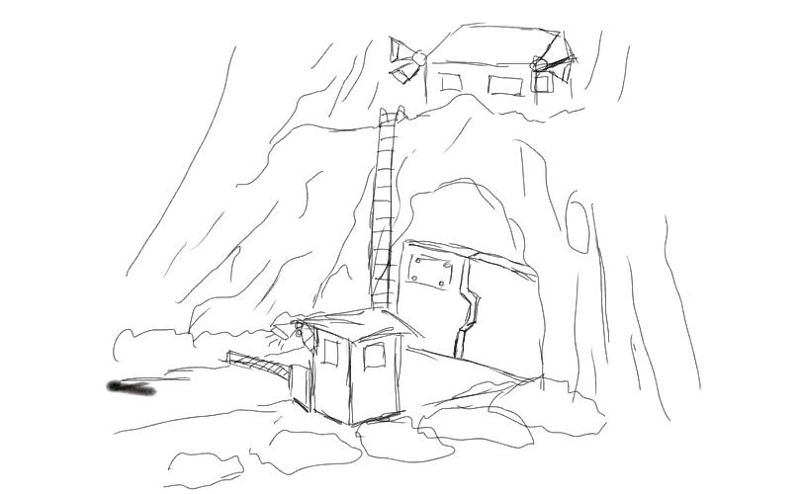
Cap'n Dread's Second Task: Midget Security Agency Sabotage
Cap Dread tells Rupert that he must get rid off of the MSA (Midget Security Agency), but has no clue as to how drive them off. Rupert shows up at the Thundercano entrance and meets Hightower.
Rupert talks him into leaving but Hightower won't pay attention to him.
Rupert realizes the MSA listens to the Thundercano announcements made by the Ventriloquist and it's the only way he can get them to abandon the facility.
Find out how to deceive midgets into abandoning the Thundercano
Forge Official Announcement Note
Rupert can visit The Ventriloquist's cabin, where he finds out the announcements are only read when they come through one of the messaging tubes.
Deliver the forged Official Announcement Note
Notes:
-llega al setting del sketch
-Sonido de ambiente (1984)
-ve el setting y se da cuenta de que los midgets le hacen caso al parlante
-habla con los midgets y trata de que ocurra el "midget riot"
-sube a la casetilla del ventrilocuo (korean starcraft pro gamer)
-trate de "slip" un mensajillo
-el ventriloco le pide a smoothface que le bote la basura y se da cuenta de que algunos mensajes vienen de la oficina del rector
-va adonde el rector
-encuentra el sello oficial del rector
-escribe la carta y le pone el sello
-la mete en el tubo
-la succión del tubo se traga a Smoothface
-llega la carta al ventrilocuo
-el ventrilocuo la lee
-efecto de sonido de tubo y metal bajo presión
-Explota el cuarto de máquinas del sistema de mensajería -Vemos una pelota que viaja por los tubos
-Toma general de la isla, vemos que el estruendo recorre toda la isla
-Sale Smoothface disparado por el tubo y le cae encima al ventrilocuo
-Ese golpe de Smoothface "triggers" el modo sirena del Ventrilocuo y se pone a hacer ruido de alarma.
-Ocurre el midget riot
-Desde adentro de la cabina escuchamos el motin
-Sale Smoothface y encuentra un Apocalypse Now

Slide 5
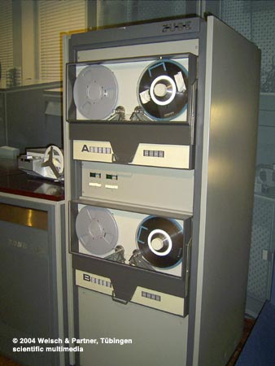
MGWDBTTGPnP Challenge: pronounce the organizations acronym
Captain Dread introduces Rupert to the MGWDBTTGPnP at the Thundercano
Lord Goat informs Rupert that he needs an evil diploma from an evil college
FALTA RAPOLEON - como convencerlo de grabar MGWDBTTGPnP
Rupert must find a way to record the Ventriloquist saying the acronym
Rupert must find a way to record the Ventriloquist saying the acronym
Rupert assembles a customized tape recorder
Rupert must make the Ventriloquist pronounce MGWDBTTGPnP and record it
Notes:
Secuencia forzada en la que, antes de abandonar el Throne of Terrors, Mocus esta repasando el manual de la organización en voz alta y Rupert escucha sobre el reto para hacerse del titulo de Master of the MGWDBTTGPnP, en el que tiene que pronunciar el acronimo de forma correcta. etc.
En ese mismo momento, ocurre otro temblor (debido al Substampede) y fortuitamente cae una de las cintas magnéticas de las super computadoras del Thundercano.

Slide 6
MGWDBTTGPnP Task: get an evil diploma from Evil Deeds
Captain Dread introduces Rupert to the MGWDBTTGPnP at the Thundercano
Lord Goat informs Rupert that he needs an evil diploma from an evil college
Lord Goat is impressed with the body of work presented by Dread for Rupert, but tells him that in order to be accepted he needs a Bachelors in Evil Arts.
Rupert attends Evil Deeds College
Mimeograph materials:
drum
ink
molds
FOOM!
In each of the classes he attends he finds materials to build a diploma copy-machine
Rupert assembles the diploma copy-machine
The machine cannot be stopped by Rupert's constant FOOM hits, which overheats it and makes it explode, leveling most of the campus
Now that the diploma is printed, Rupert needs the Rector's signature for its validity
Rupert introduces himself as the Rector's wife attorney and needs the signature for the final paperwork to be completed. The Rector takes this opportunity to rant about marriage.
Notes:
Despues de hablar con Dread, es presentado a Goat, quien solicita que pase a la U. Dread informa que nadie se ha graduado de ahí nunca.
En la U hay 3 clases:
Kung Foom! (de acá saca el skill de Foom! y la trompeta para la grabadora)
Diabolical Machines, etc ( de acá saca el tambor)
Maniacal Laughter (al completar la shit, se ríe como le enseñaron)
Al finalizar las 3 clases, requiere pasar a la oficina del
rector. Para falsificar su titulo, requiere armar un Mimeógrafo: (http://images2.dailykos.com/images/user/899/pic_mimeograph.jpg)
Oficina del Rector: Aqui encuentra la tinta en el escritorio
en la oficina hay una caja fuerte de donde sale el "molde"
.
Cuando tiene todas las shits, escucha a su profesor decir "use the Foom Baldie!"

